Slide 1
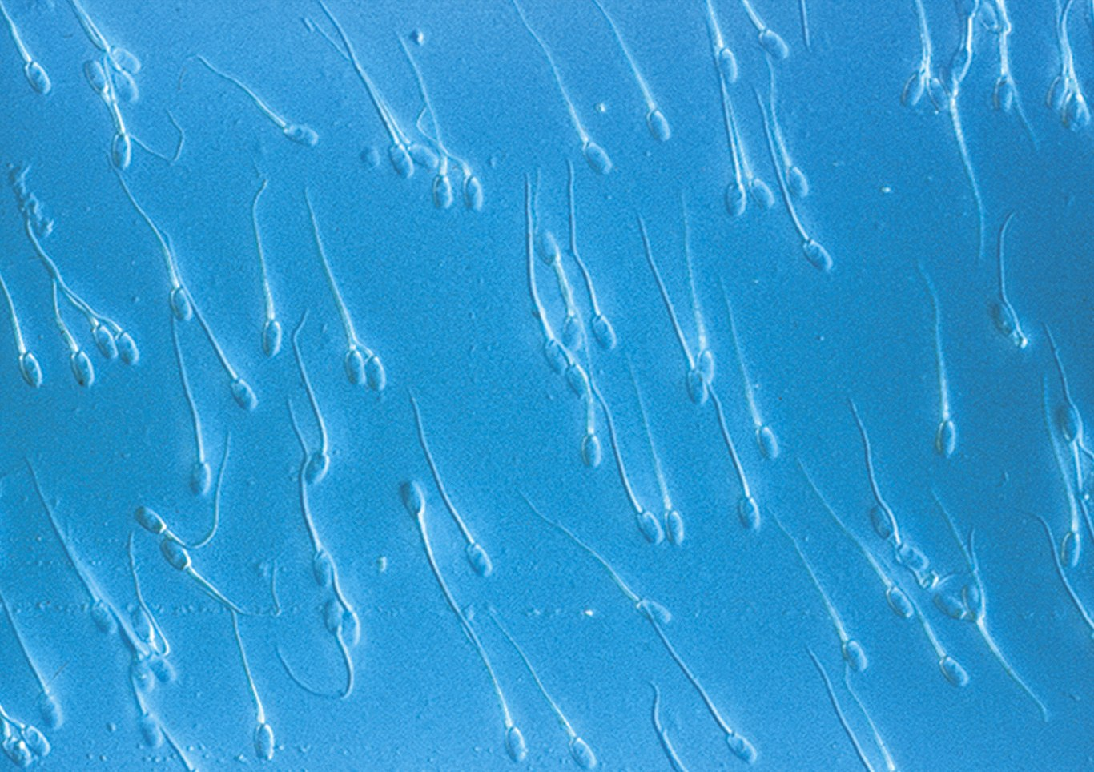
Cell Structure and Function

Slide 2
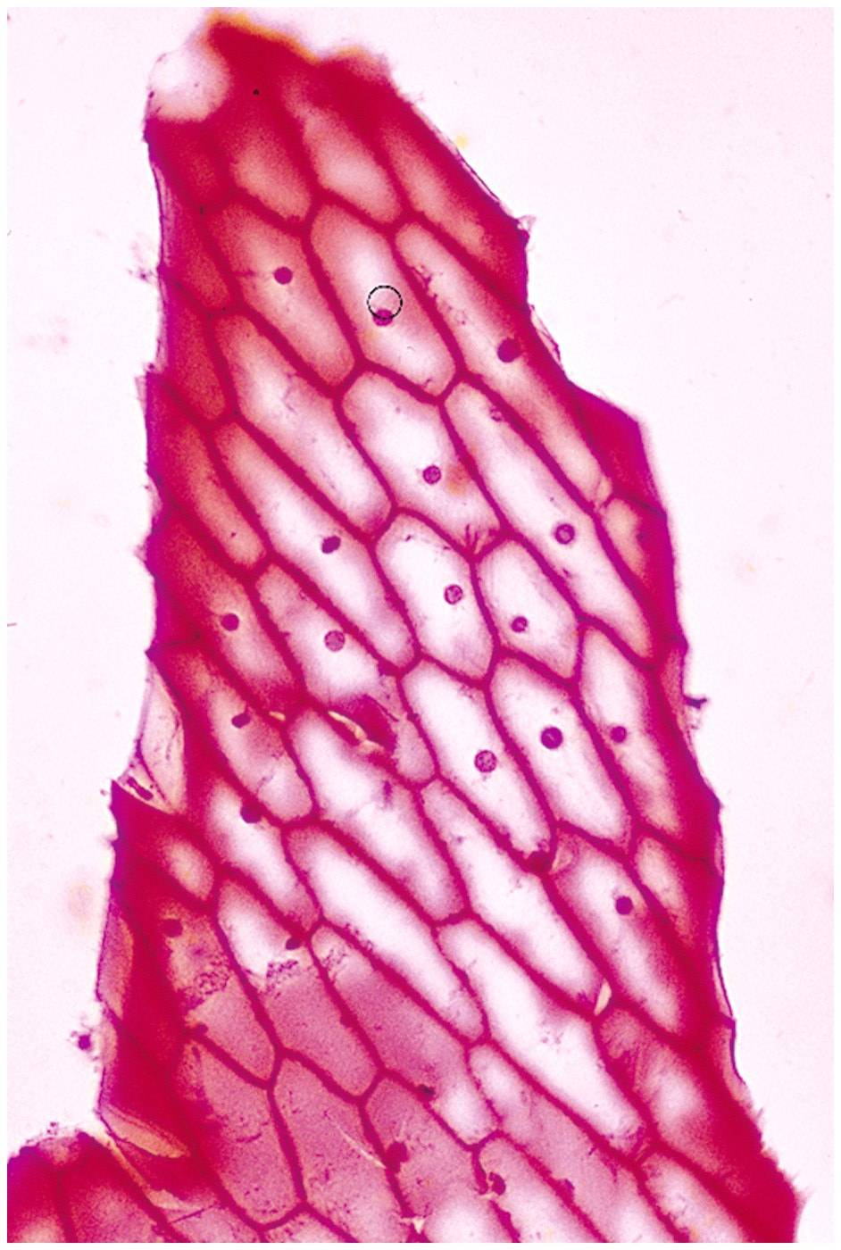
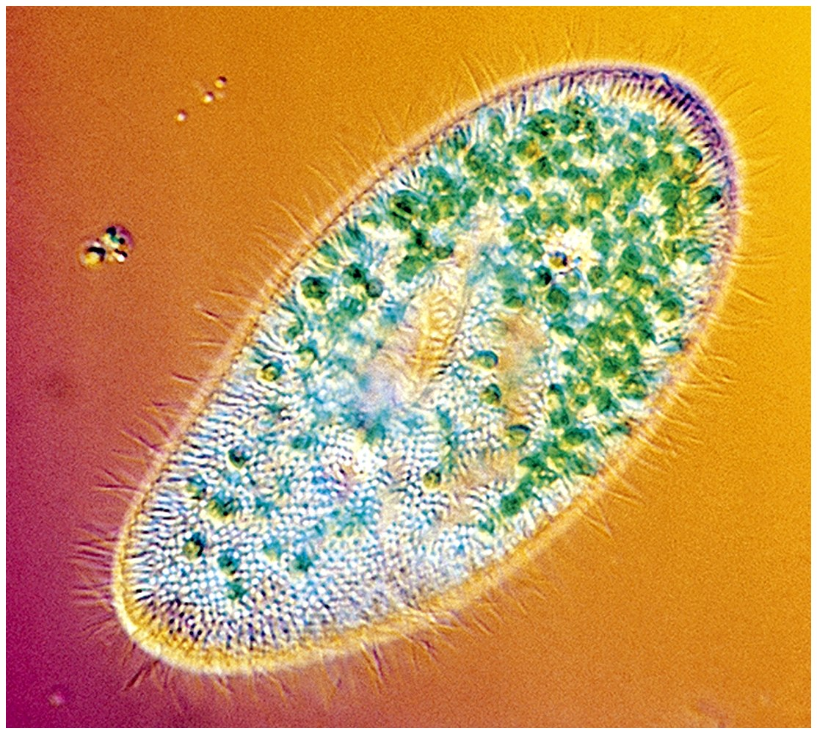
Cells
Smallest living unit
Most are microscopic

Slide 3
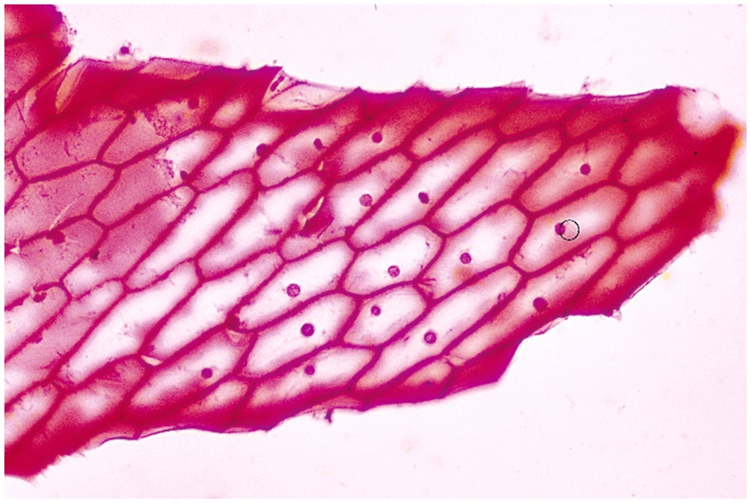
Discovery of Cells
Robert Hooke (mid-1600s)
Observed sliver of cork
Saw “row of empty boxes”
Coined the term cell

Slide 4

Cell theory
(1839)Theodor Schwann & Matthias Schleiden
“ all living things are made of cells”
(50 yrs. later) Rudolf Virchow
“all cells come from cells”

Slide 5
Principles of Cell Theory
All living things are made of cells
Smallest living unit of structure and function of all organisms is the cell
All cells arise from preexisting cells
(this principle discarded the idea of
spontaneous generation)

Slide 6
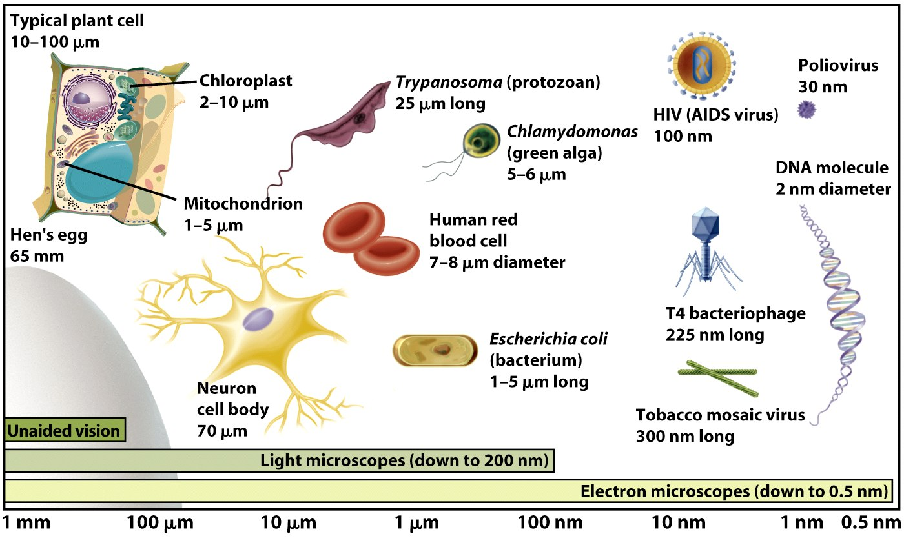
Cell Size

Slide 7
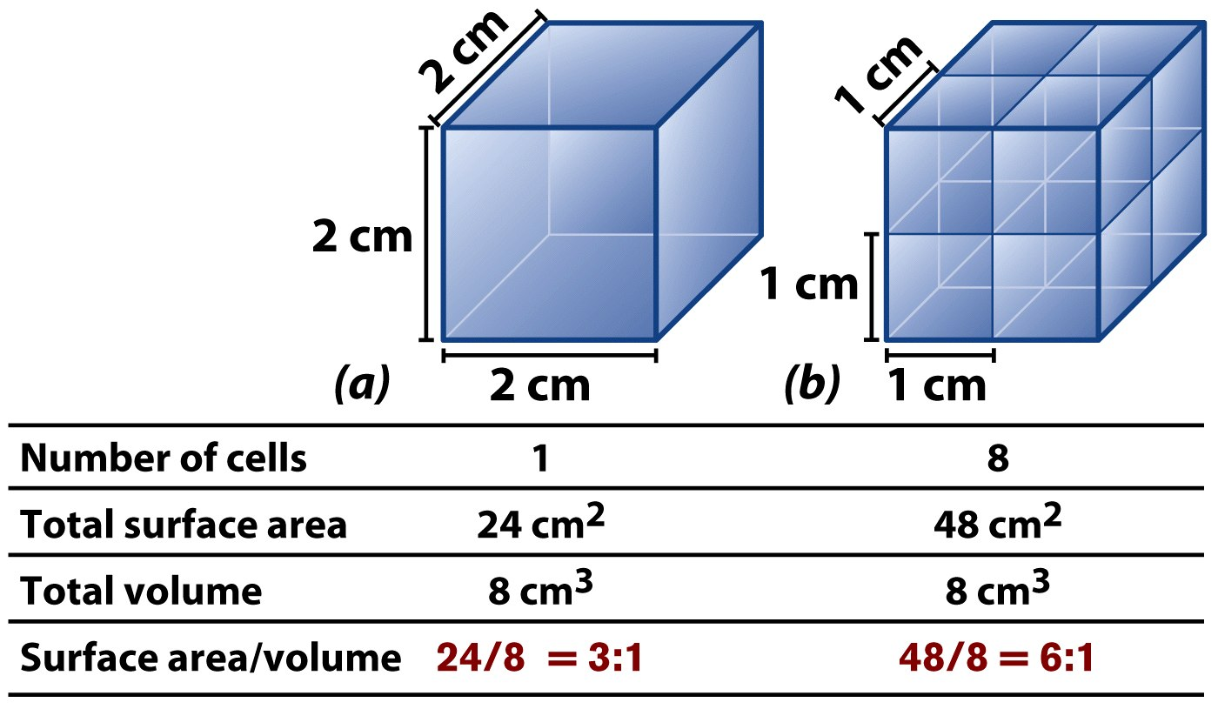
Cells Have Large Surface Area-to-Volume Ratio

Slide 8
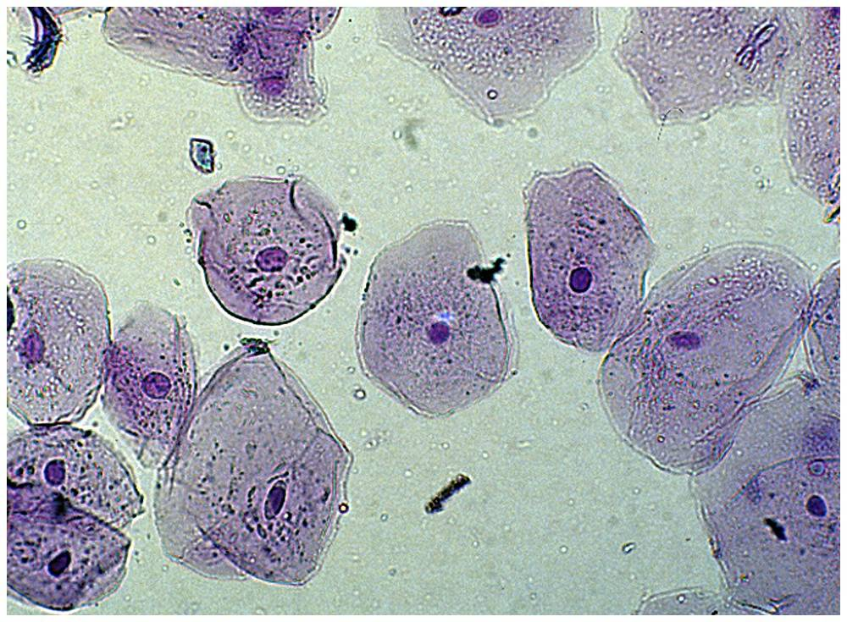
Characteristics of All Cells
A surrounding membrane
Protoplasm – cell contents in thick fluid
Organelles – structures for cell function
Control center with DNA

Slide 9
The cytoskeleton, organelles, and inclusions are embedded in a clear gel called the cytosol or intracellular fluid (ICF).
All body fluids not contained in the cells are collectively called the extracellular fluid (ECF). The ECF located amid the cells is also called tissue (interstitial) fluid. Some other extracellular fluids

Slide 10
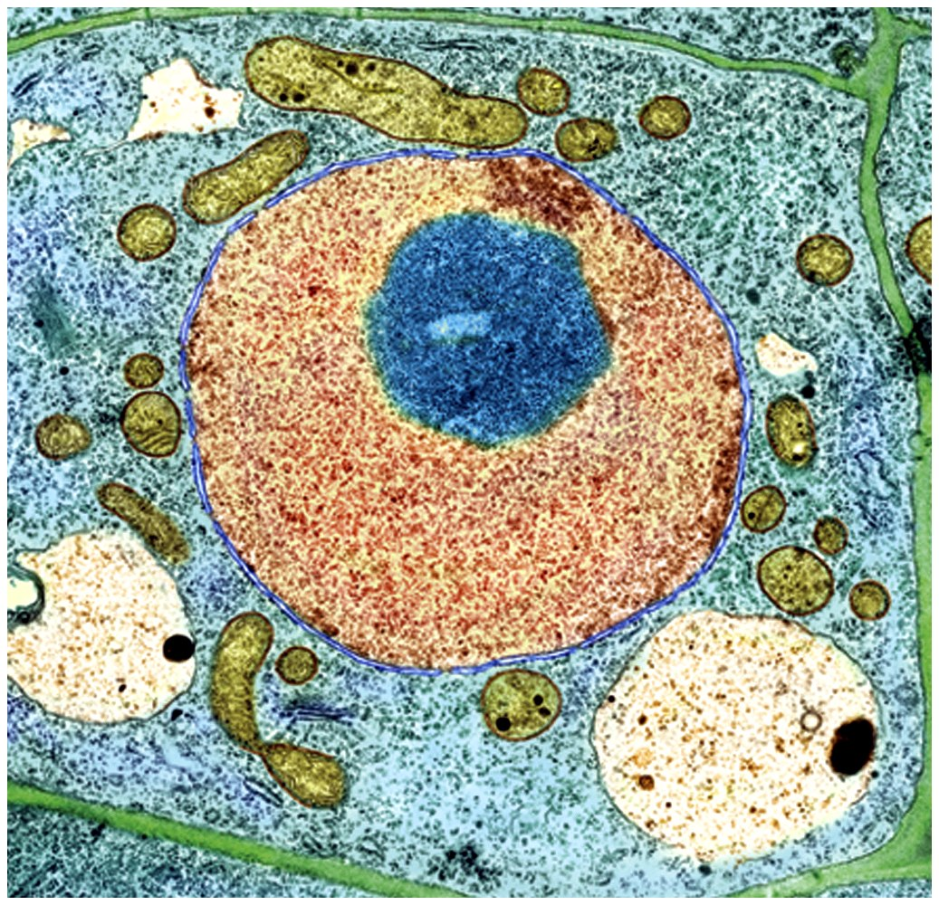
Cell Types
Prokaryotic
Eukaryotic

Slide 11
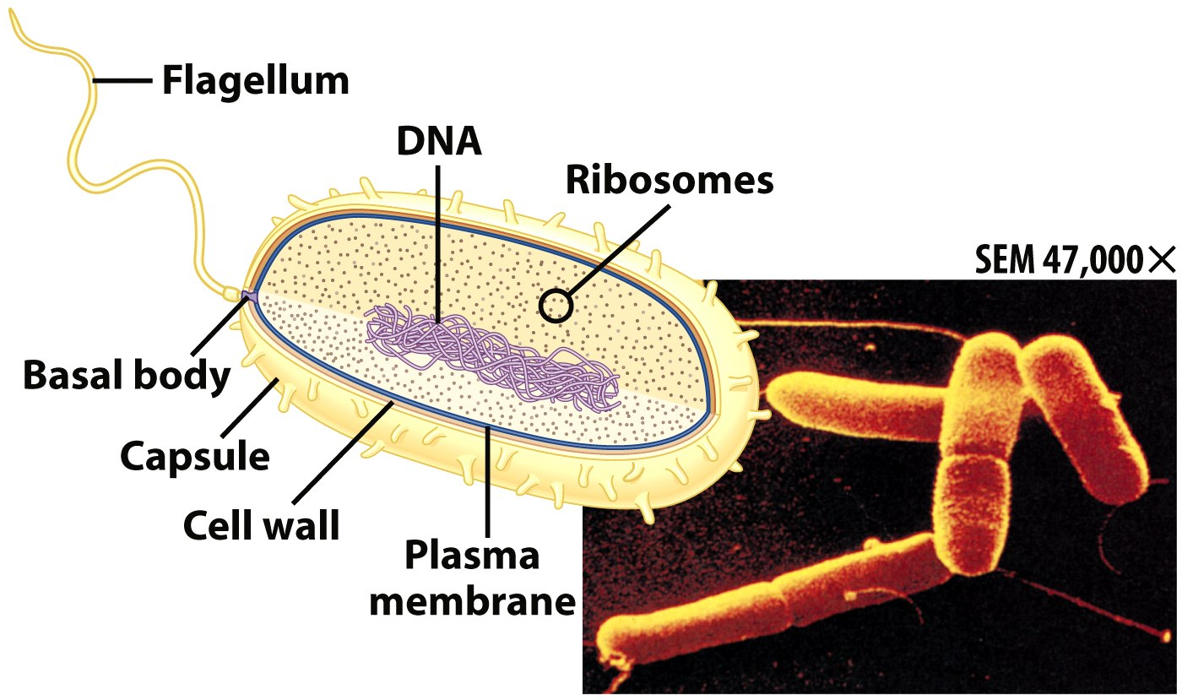
Prokaryotic Cells
First cell type on earth
Cell type of Bacteria and Archaea

Slide 12
Prokaryotic Cells
No membrane bound nucleus
Nucleoid = region of DNA concentration
Organelles not bound by membranes

Slide 13
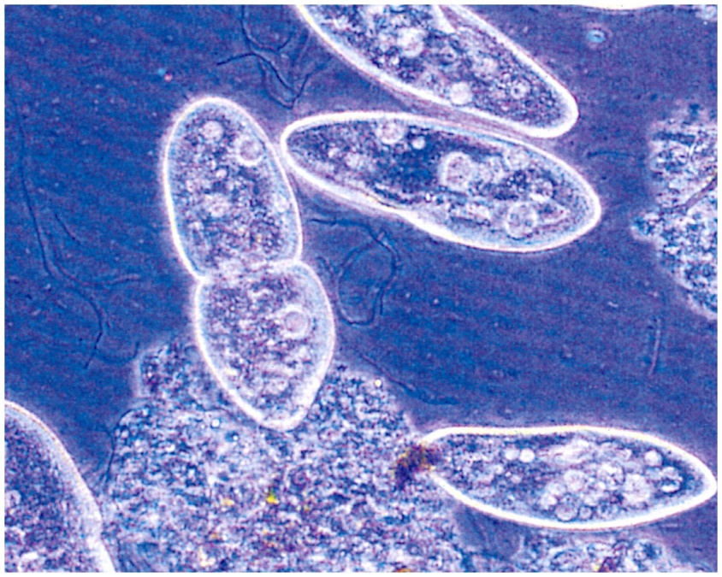
Eukaryotic Cells
Nucleus bound by membrane
Include fungi, protists, plant, and animal cells
Possess many organelles
Protozoan

Slide 14
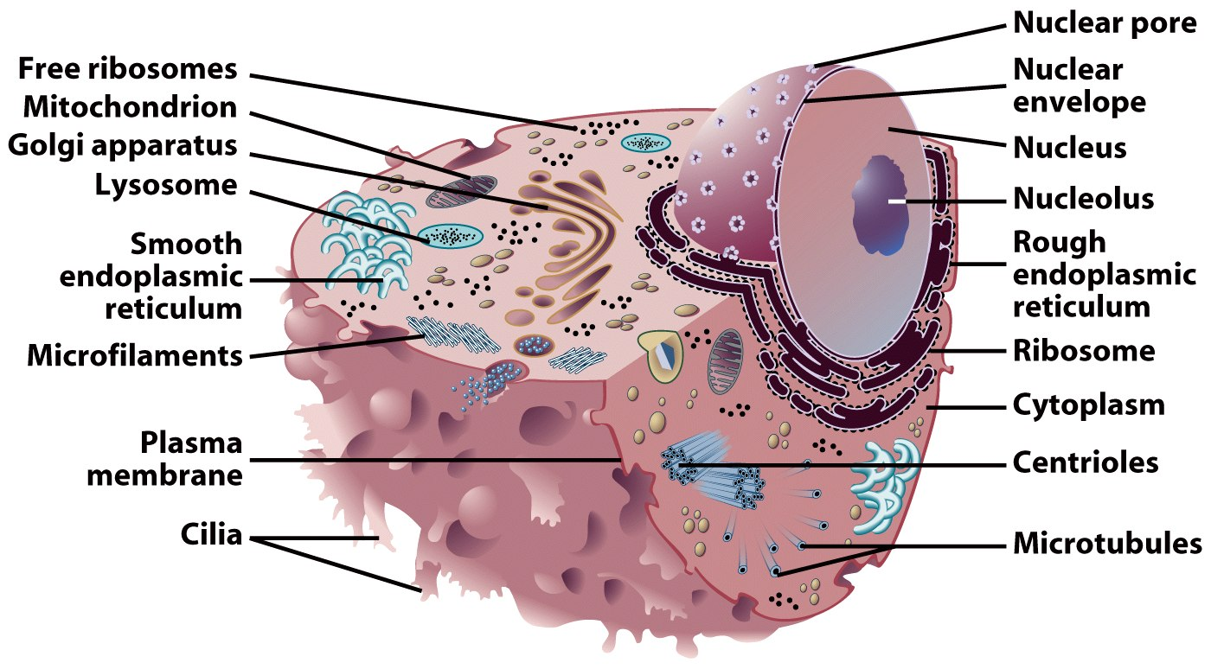
Representative Animal Cell

Slide 15
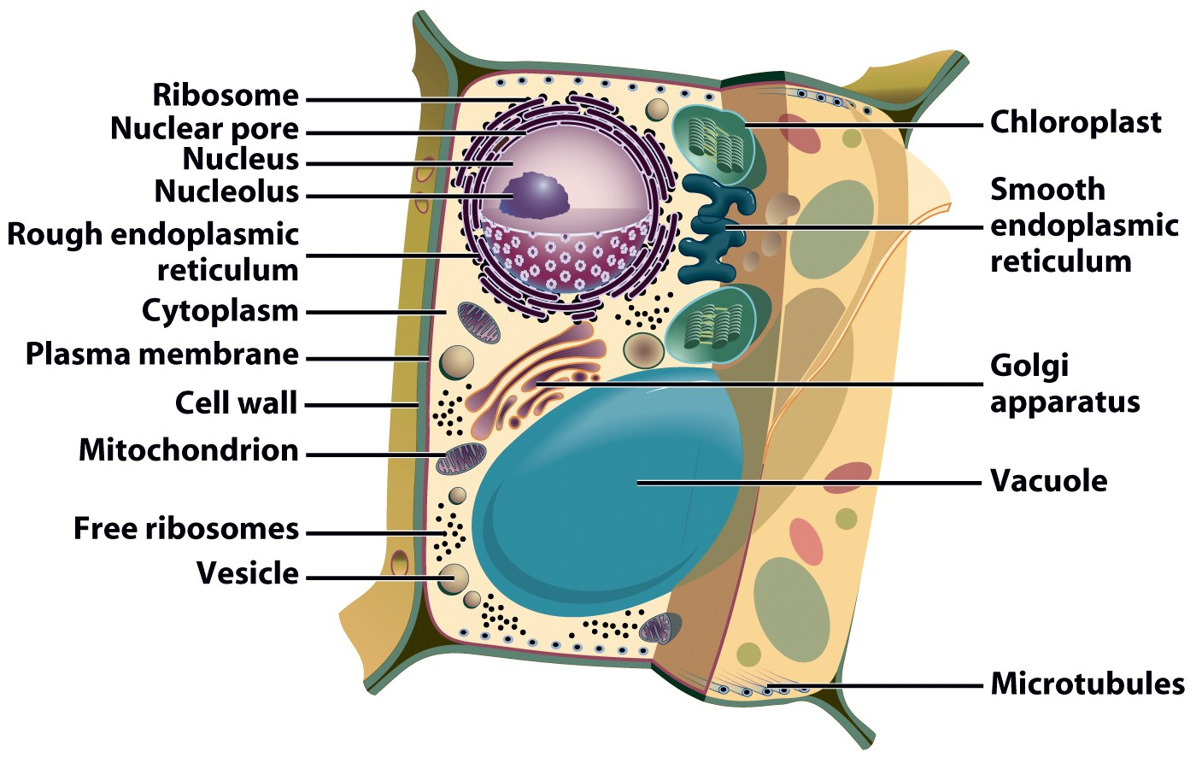
Representative Plant Cell

Slide 16
Organelles
Cellular machinery
Two general kinds
Derived from membranes
Bacteria-like organelles

Slide 17
Bacteria-Like Organelles
Derived from symbiotic bacteria
Ancient association
Endosymbiotic theory
Evolution of modern cells from cells & symbiotic bacteria

Slide 18
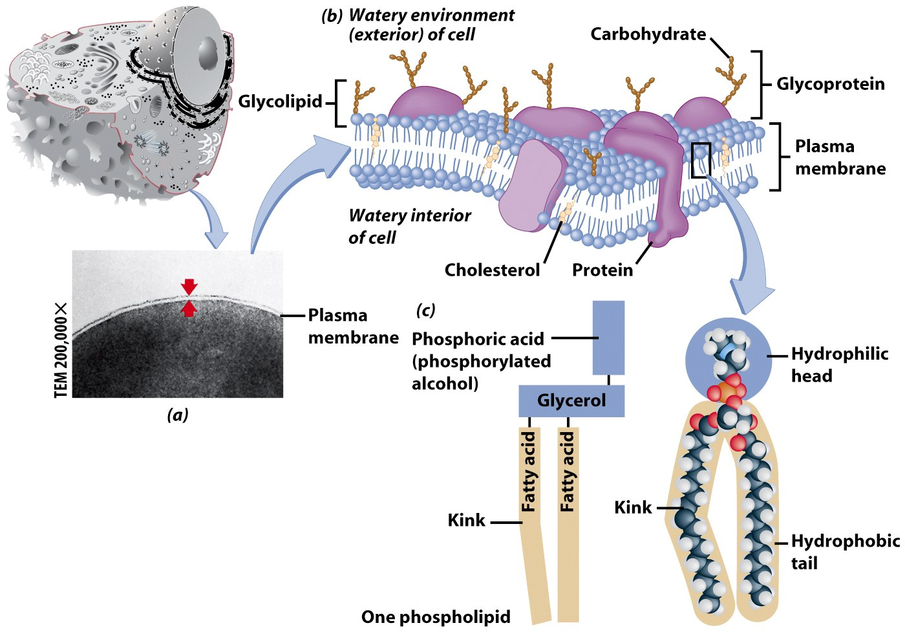
Plasma Membrane
Contains cell contents
Double layer of phospholipids & proteins

Slide 19
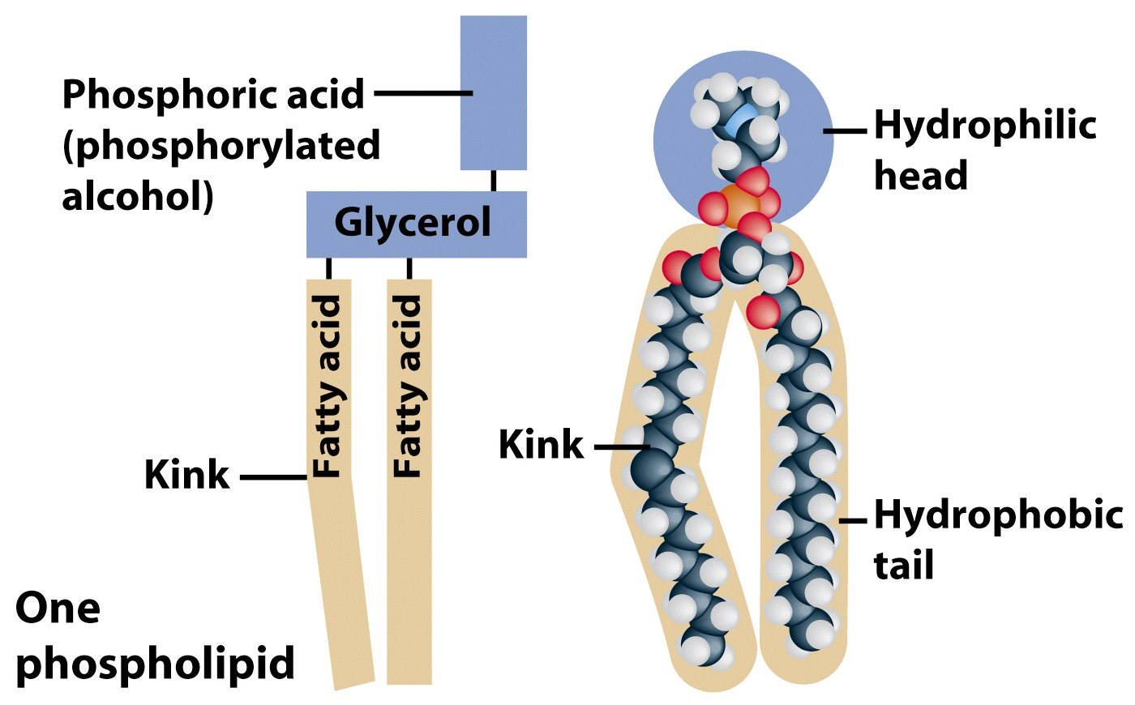
Phospholipids
Polar
Hydrophylic head
Hydrophobic tail
Interacts with water

Slide 20
Movement Across the Plasma Membrane
A few molecules move freely
Water, Carbon dioxide, Ammonia, Oxygen
Carrier proteins transport some molecules
Proteins embedded in lipid bilayer
Fluid mosaic model – describes fluid nature of a lipid bilayer with proteins

Slide 21
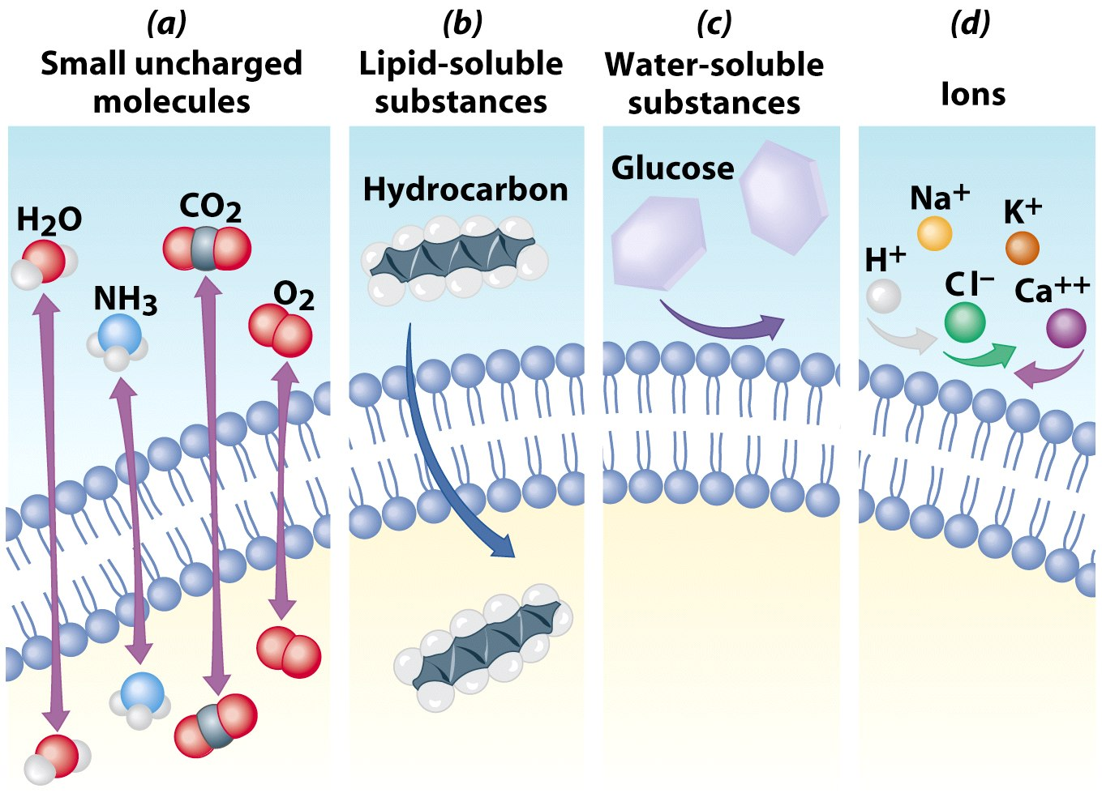

Slide 22
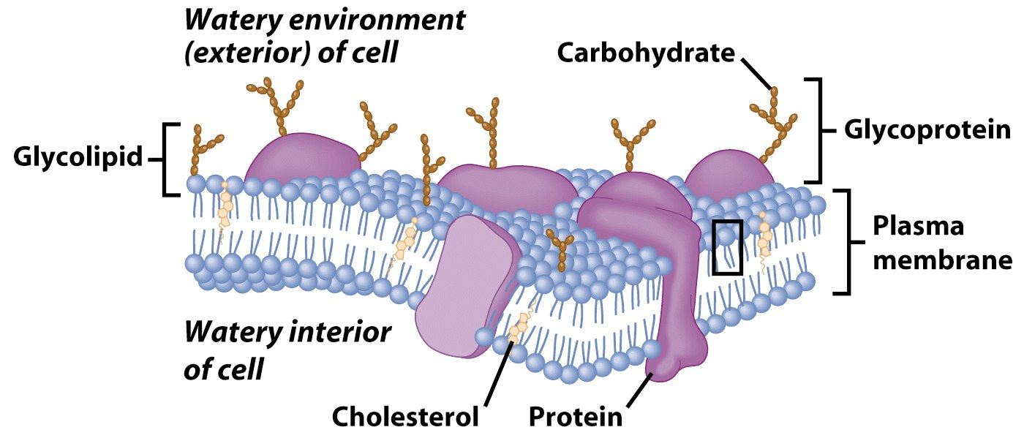
Membrane Proteins
1. Channels or transporters
Move molecules in one direction
2. Receptors
Recognize certain chemicals

Slide 23
Membrane Proteins
3. Glycoproteins
Identify cell type
4. Enzymes
Catalyze production of substances
Notes:
Expl of glycoprotein is abo blood group

Slide 24
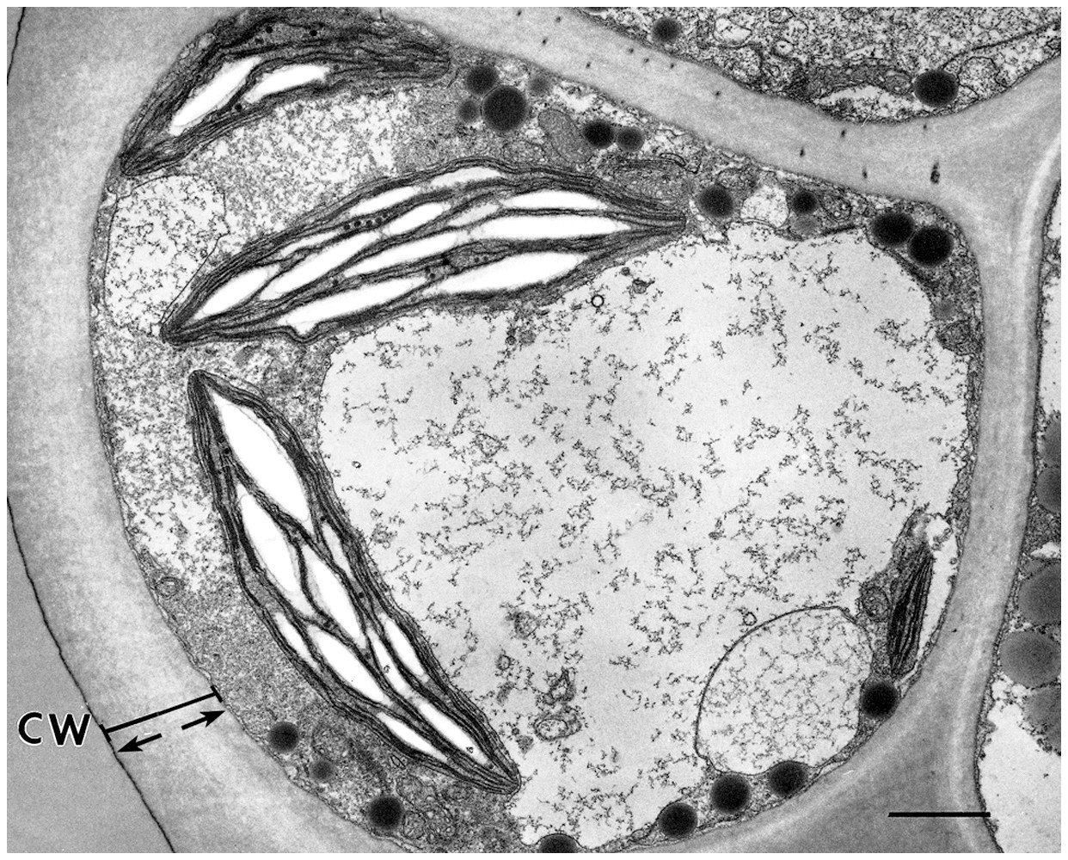
Cell Walls
Found in plants, fungi, & many protists
Surrounds plasma membrane

Slide 25
Cell Wall Differences
Plants – mostly cellulose
Fungi – contain chitin

Slide 26
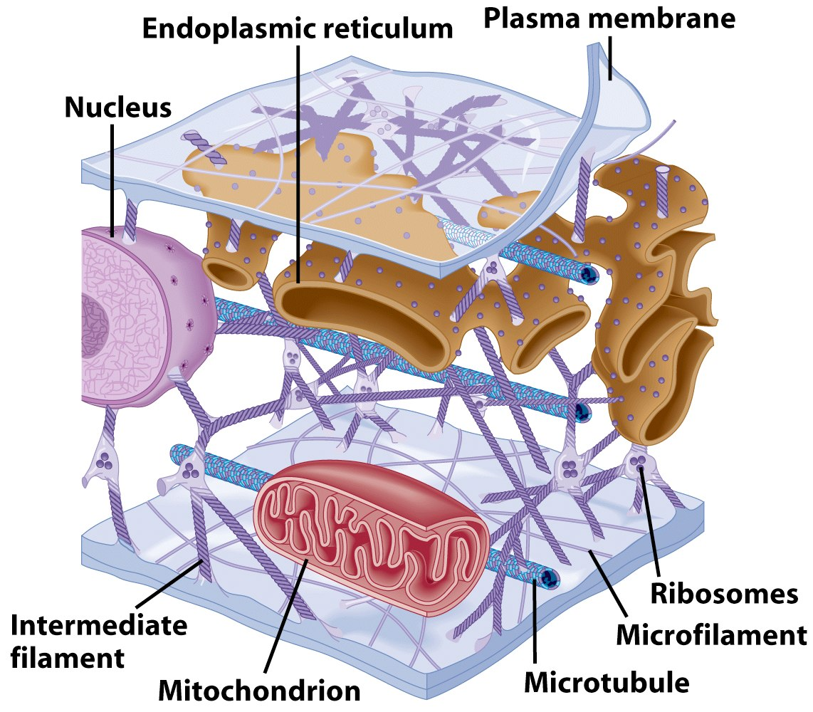
Cytoplasm
Viscous fluid containing organelles
components of cytoplasm
Interconnected filaments & fibers
Fluid = cytosol
Organelles (not nucleus)
storage substances

Slide 27
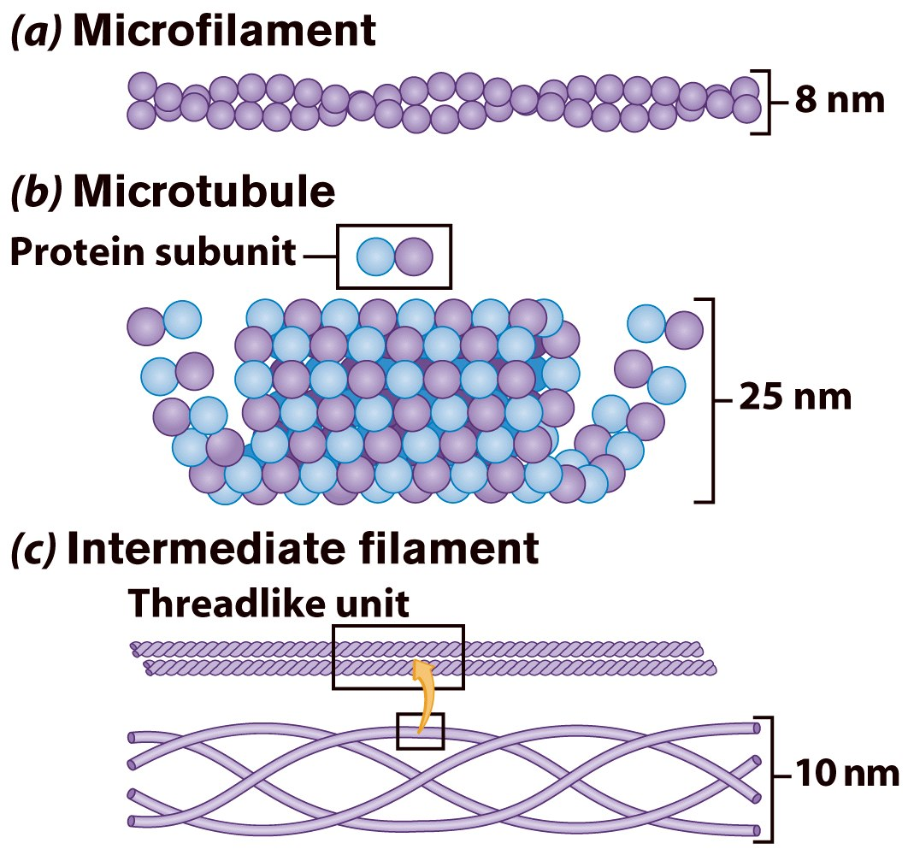
Cytoskeleton
Filaments & fibers
Made of 3 fiber types
Microfilaments
Microtubules
Intermediate filaments
3 functions:
mechanical support
anchor organelles
help move substances

Slide 28
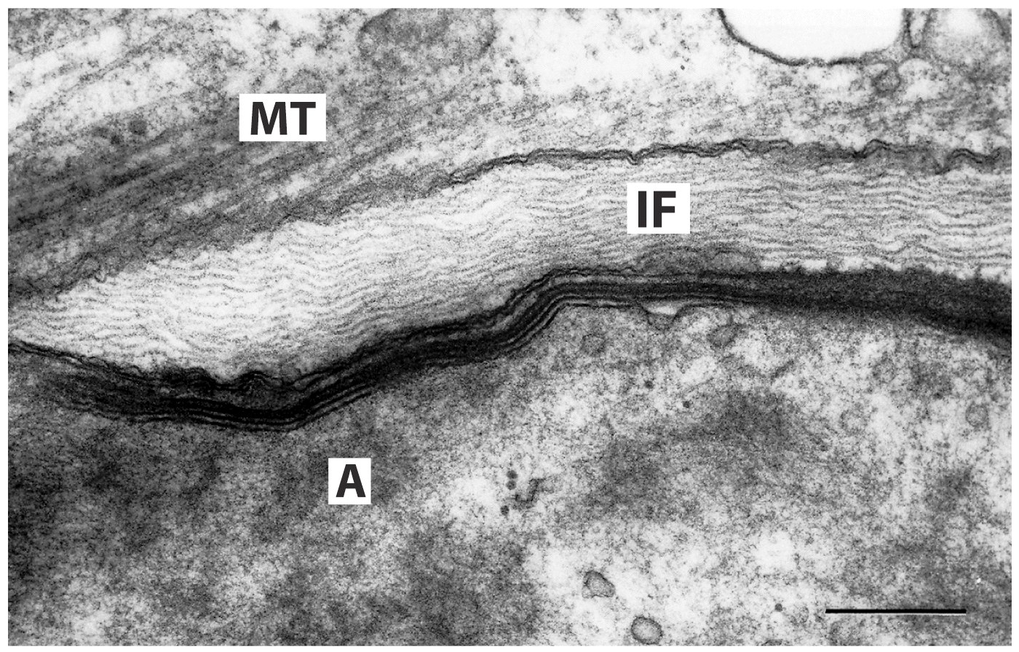
A = actin, IF = intermediate filament, MT = microtubule

Slide 29

Cilia & Flagella
Provide motility
Cilia
Short
Used to move substances outside human cells
Flagella
Whip-like extensions
Found on sperm cells
Basal bodies like centrioles

Slide 30
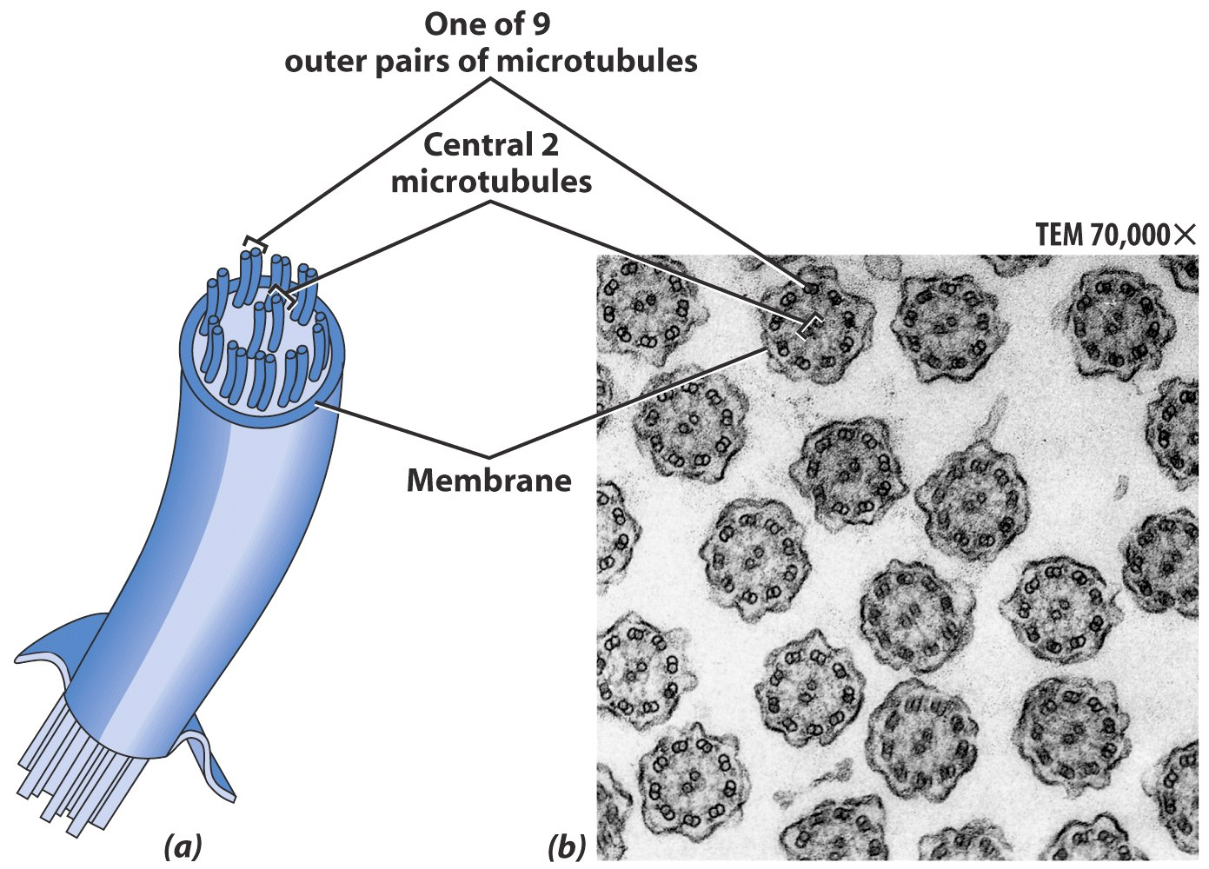
Cilia & Flagella Structure
Bundles of microtubules
With plasma membrane

Slide 31
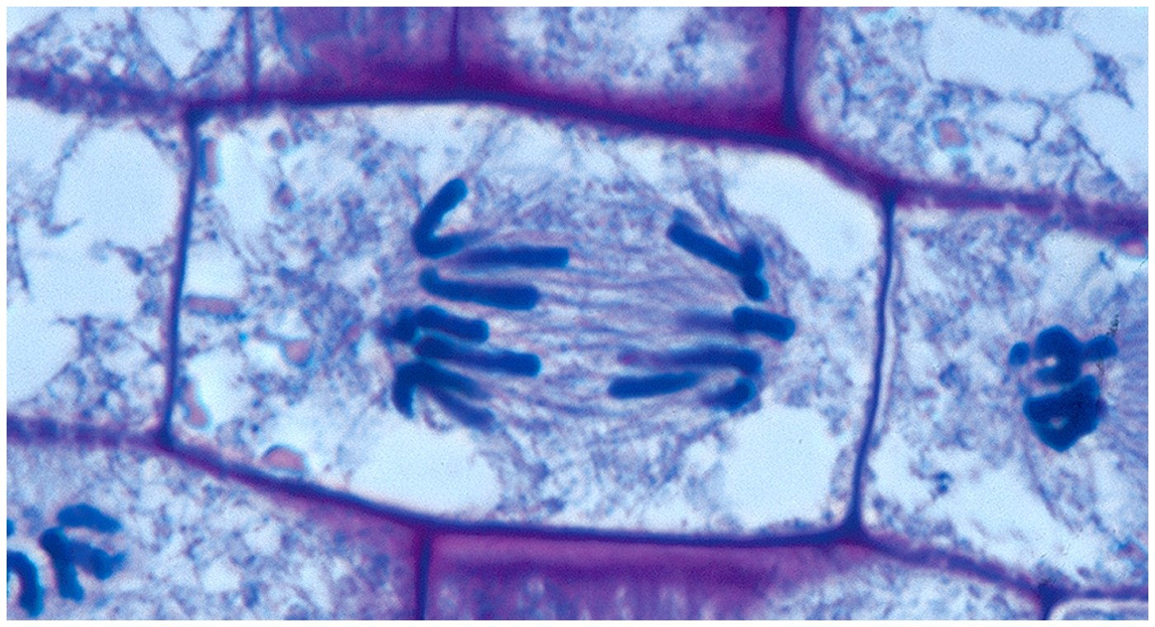
Centrioles
Pairs of microtubular structures
Play a role in cell division

Slide 32
Membranous Organelles
Functional components within cytoplasm
Bound by membranes

Slide 33
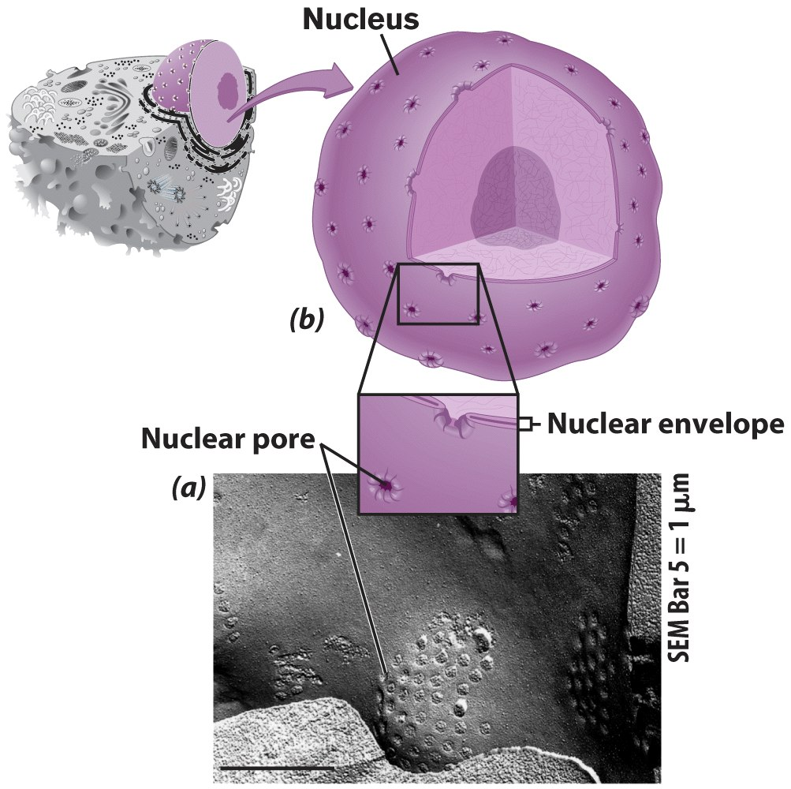
Nucleus
Control center of cell
Double membrane
Contains
Chromosomes
Nucleolus

Slide 34
Nuclear Envelope
Separates nucleus from rest of cell
Double membrane
Has pores

Slide 35
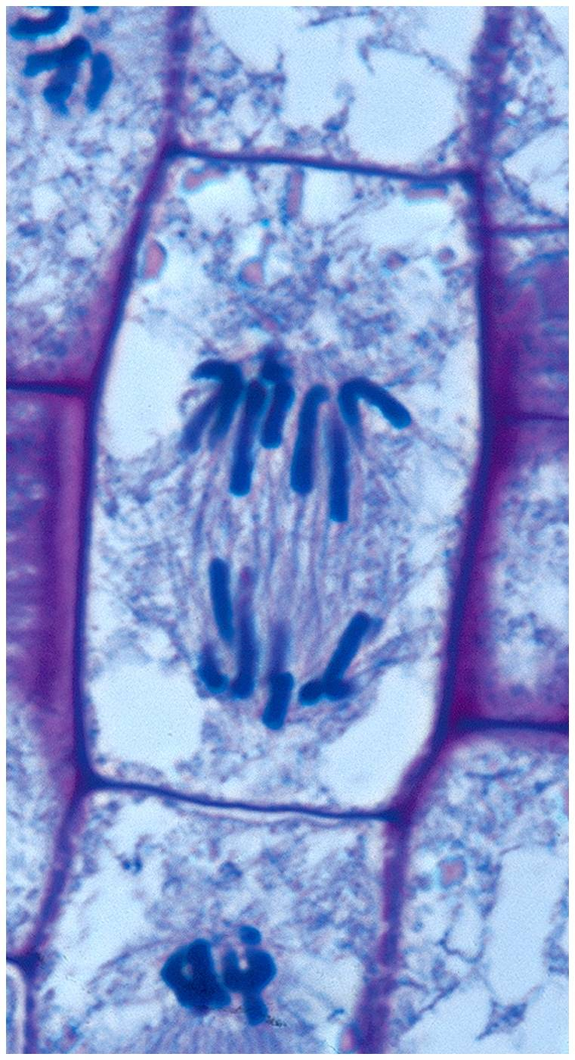
DNA
Hereditary material
Chromosomes
DNA
Protiens
Form for cell division
Chromatin

Slide 36
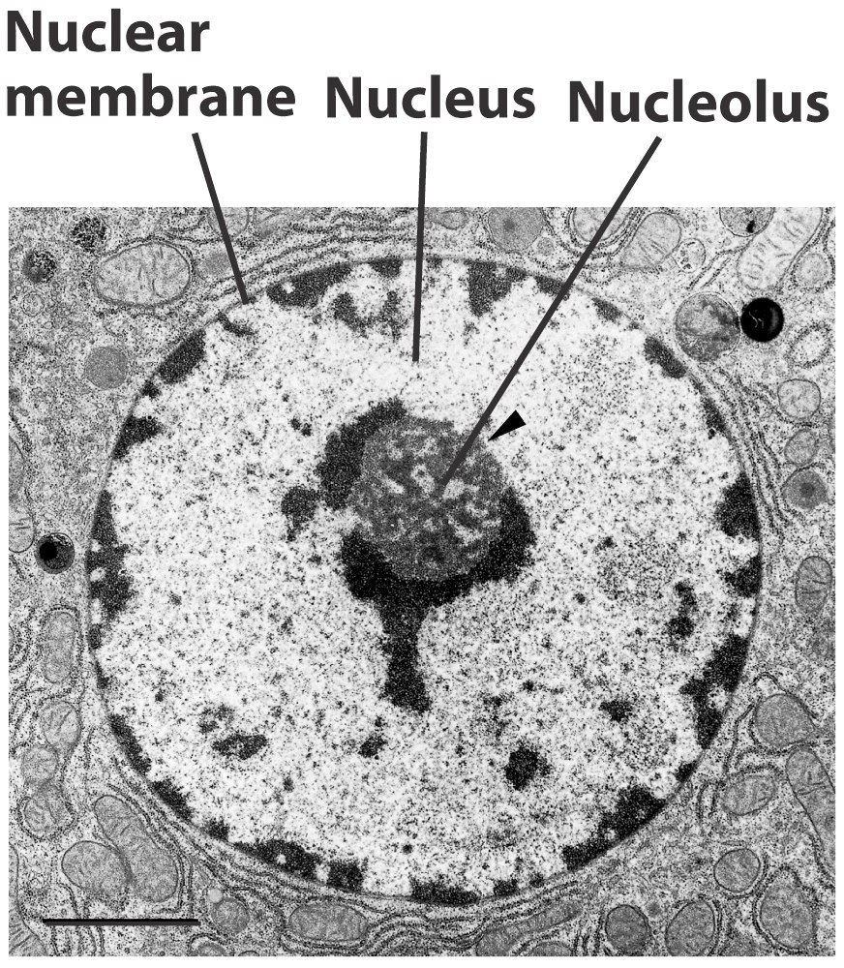
Nucleolus
Most cells have 2 or more
Directs synthesis of RNA
Forms ribosomes

Slide 37
Endoplasmic Reticulum
Helps move substances within cells
Network of interconnected membranes
Two types
Rough endoplasmic reticulum
Smooth endoplasmic reticulum

Slide 38
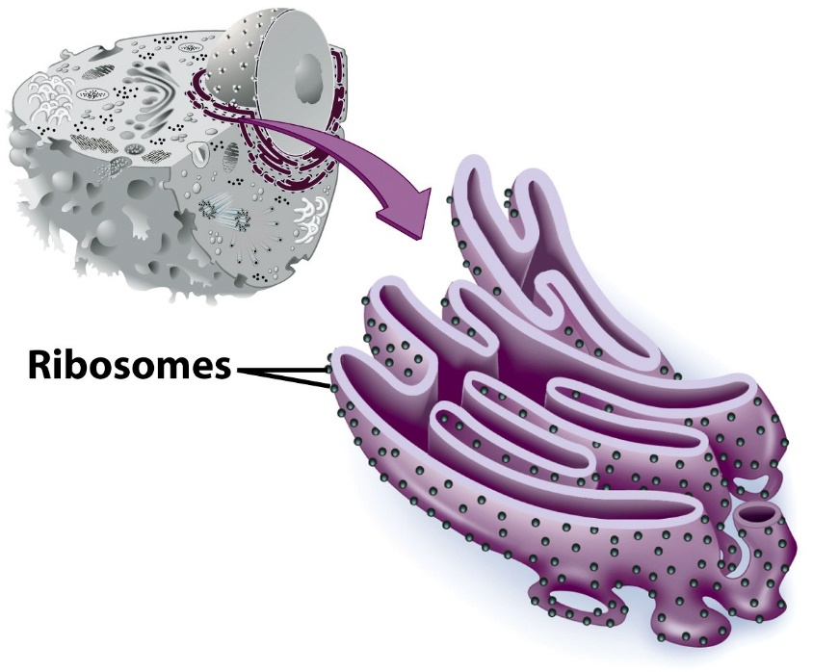
Rough Endoplasmic Reticulum
Ribosomes attached to surface
Manufacture protiens
Not all ribosomes attached to rough ER
May modify proteins from ribosomes

Slide 39
Smooth Endoplasmic Reticulum
No attached ribosomes
Has enzymes that help build molecules
Carbohydrates
Lipids

Slide 40
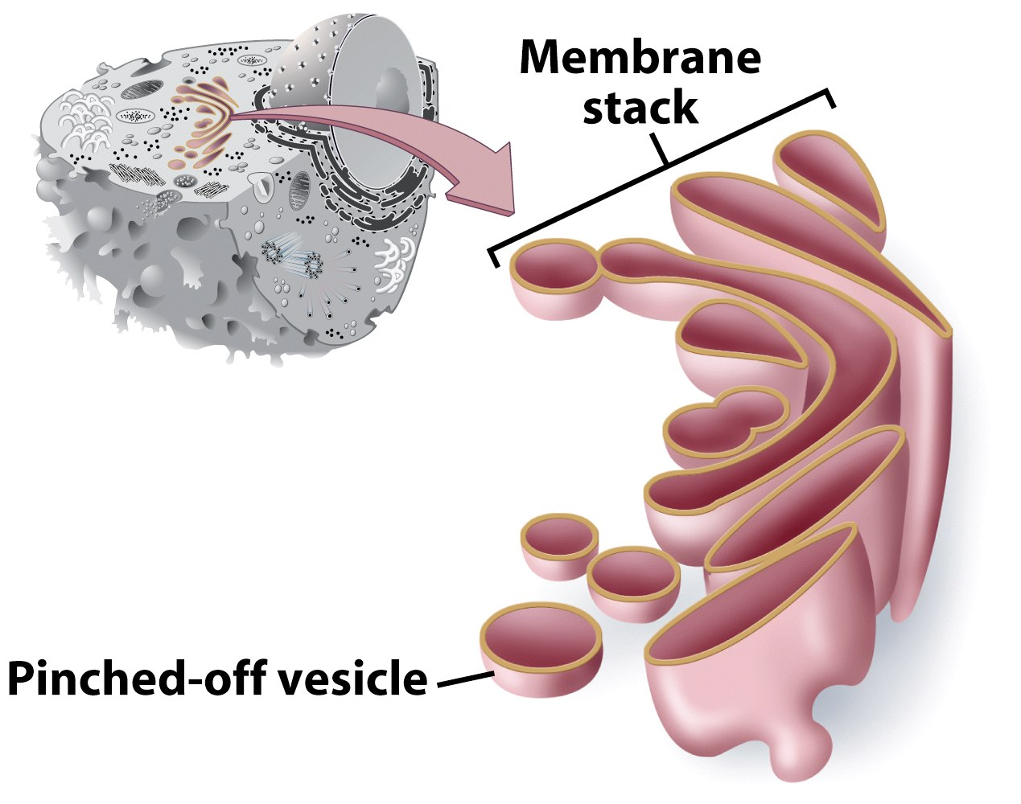
Golgi Apparatus
Involved in synthesis of plant cell wall
Packaging & shipping station of cell

Slide 41
Golgi Apparatus Function
1. Molecules come in vesicles
2. Vesicles fuse with Golgi membrane
3. Molecules may be modified by Golgi

Slide 42
Golgi Apparatus Function (Continued)
4. Molecules pinched-off in separate vesicle
5. Vesicle leaves Golgi apparatus
6. Vesicles may combine with plasma membrane to secrete contents

Slide 43
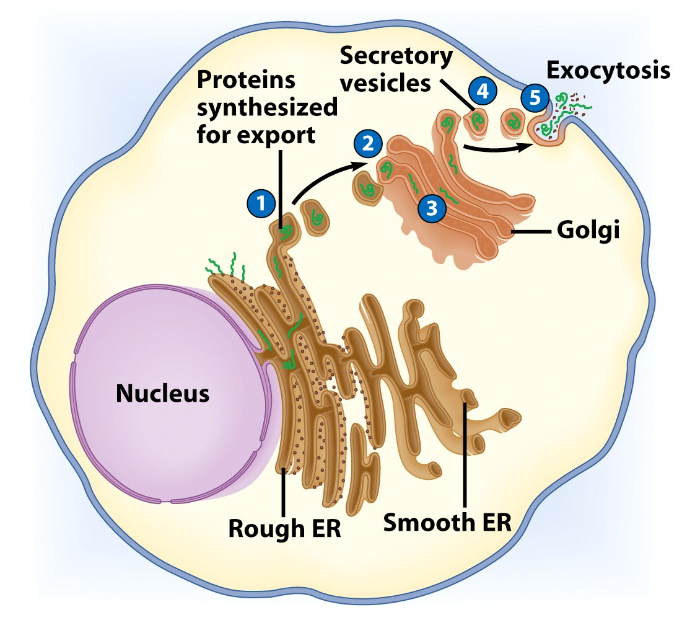

Slide 44
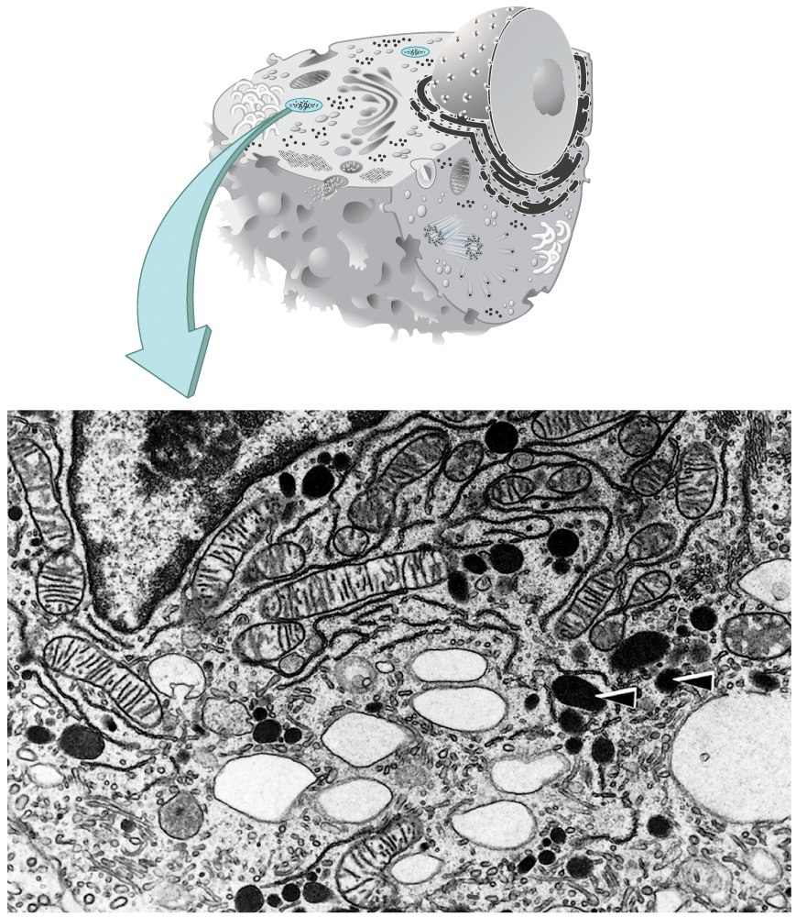
Lysosomes
Contain digestive enzymes
Functions
Aid in cell renewal
Break down old cell parts
Digests invaders

Slide 45
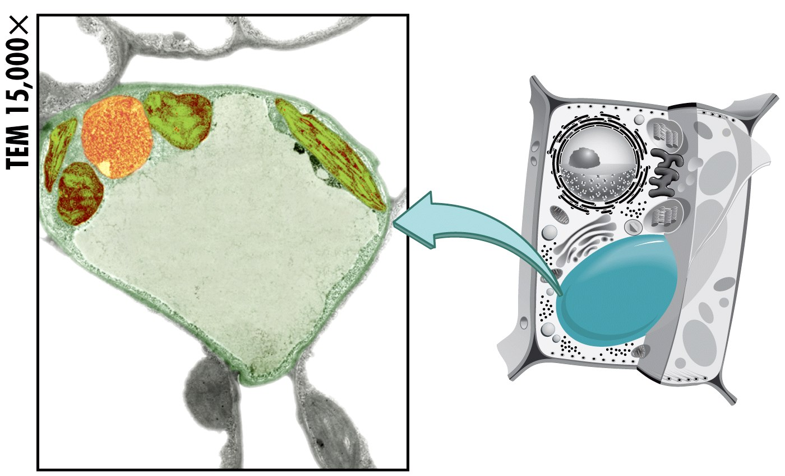
Vacuoles
Membrane bound storage sacs
More common in plants than animals
Contents
Water
Food
wastes

Slide 46
Bacteria-Like Organelles
Release & store energy
Types
Mitochondria
(release energy)
Chloroplasts
(store energy)

Slide 47
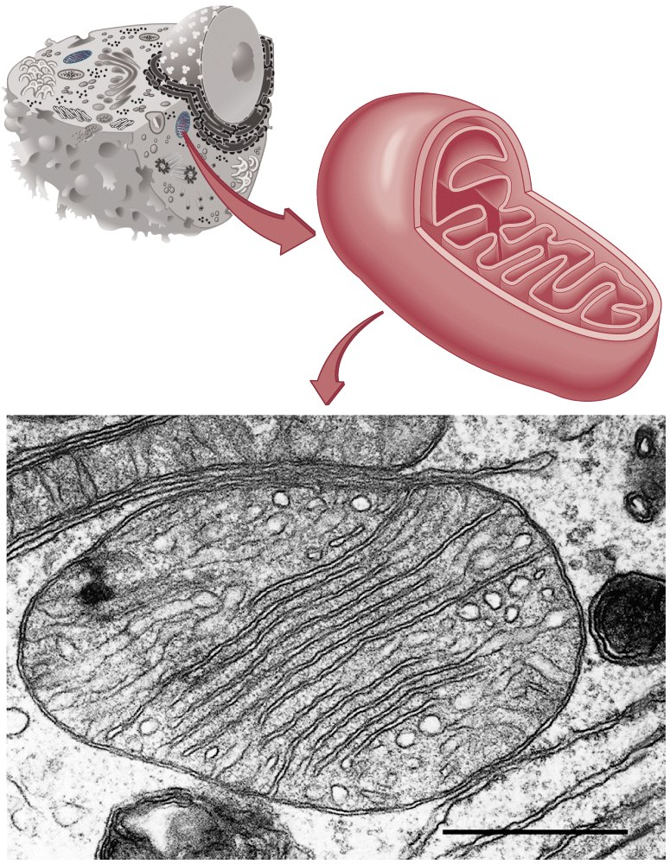
Mitochondria
Have their own DNA
Bound by double membrane

Slide 48
Mitochondria
Break down fuel molecules (cellular respiration)
Glucose
Fatty acids
Release energy
ATP

Slide 49
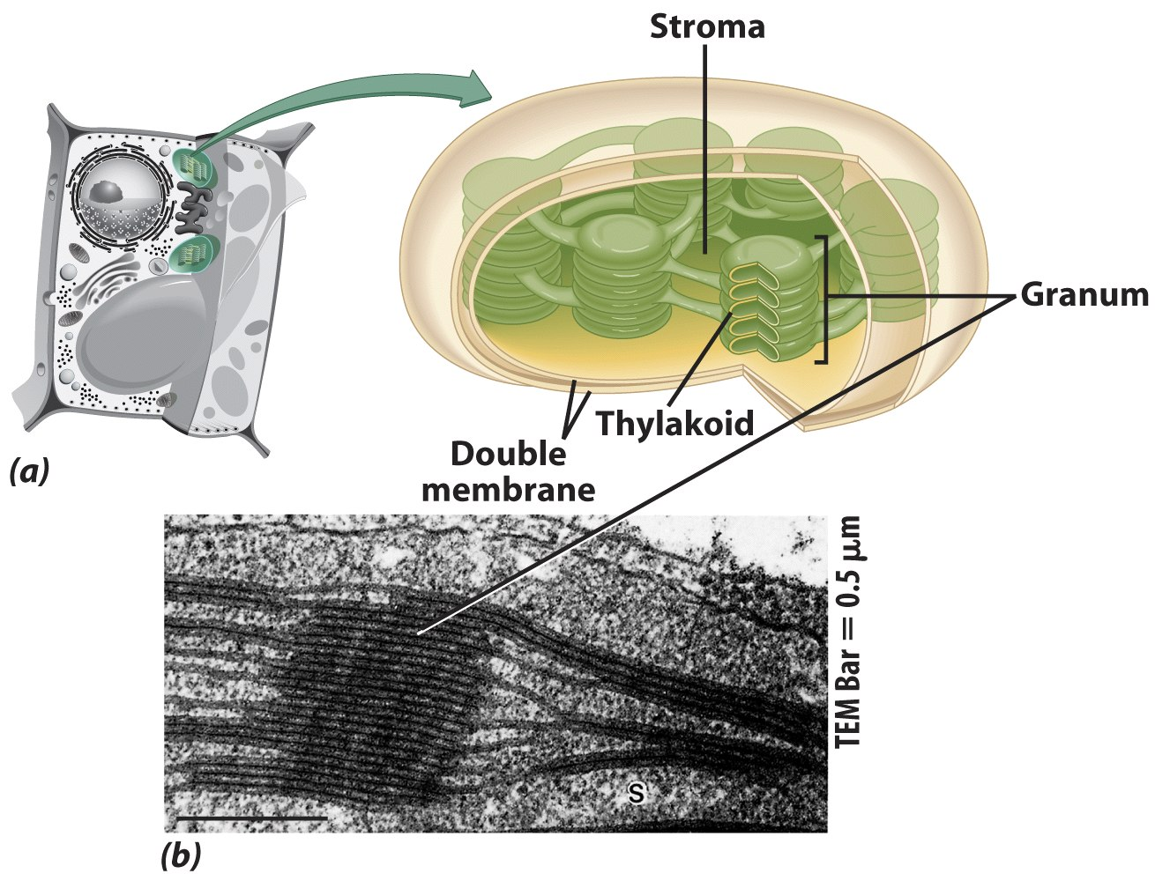
Chloroplasts
Derived form photosynthetic bacteria
Solar energy capturing organelle

Slide 50
Photosynthesis
Takes place in the chloroplast
Makes cellular food – glucose

Slide 51
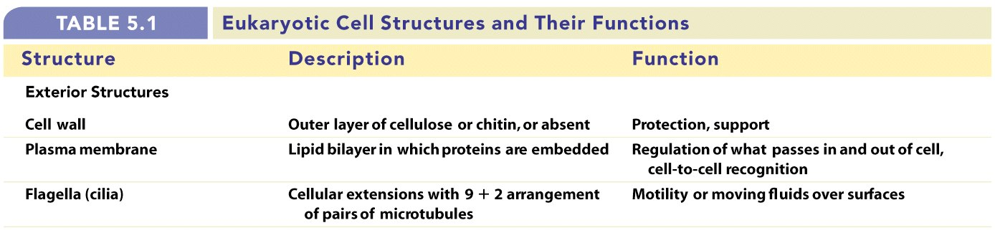
Review of Eukaryotic Cells

Slide 52
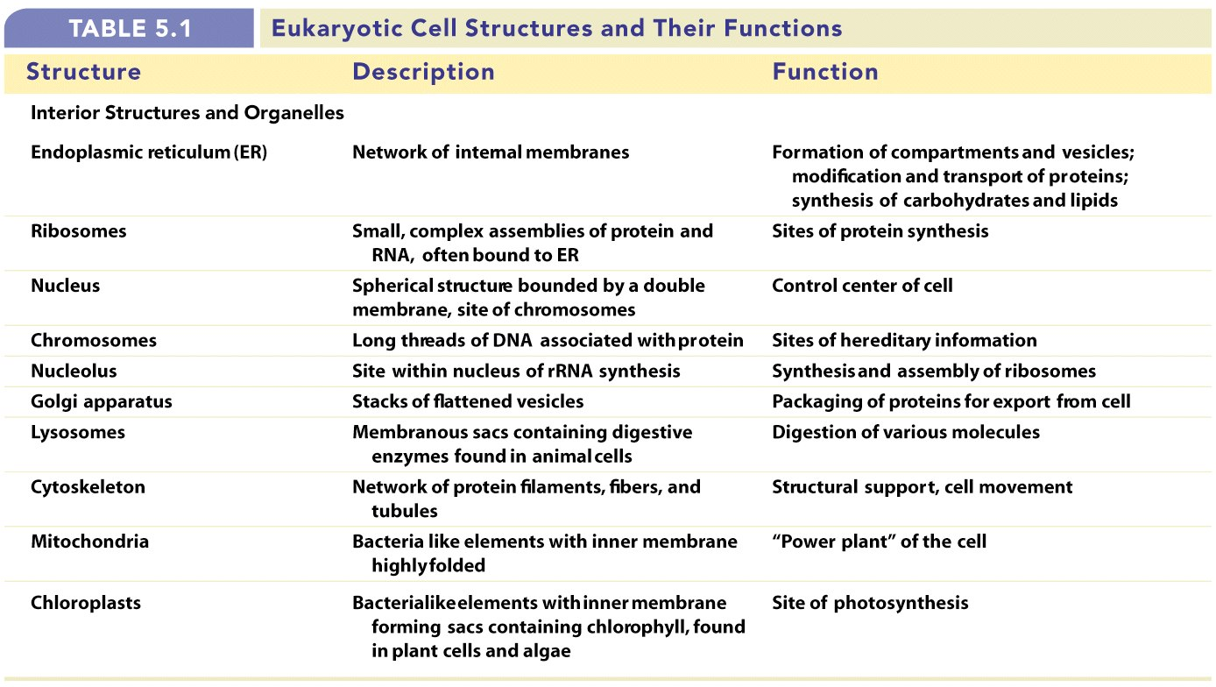
Review of Eukaryotic Cells

Slide 53
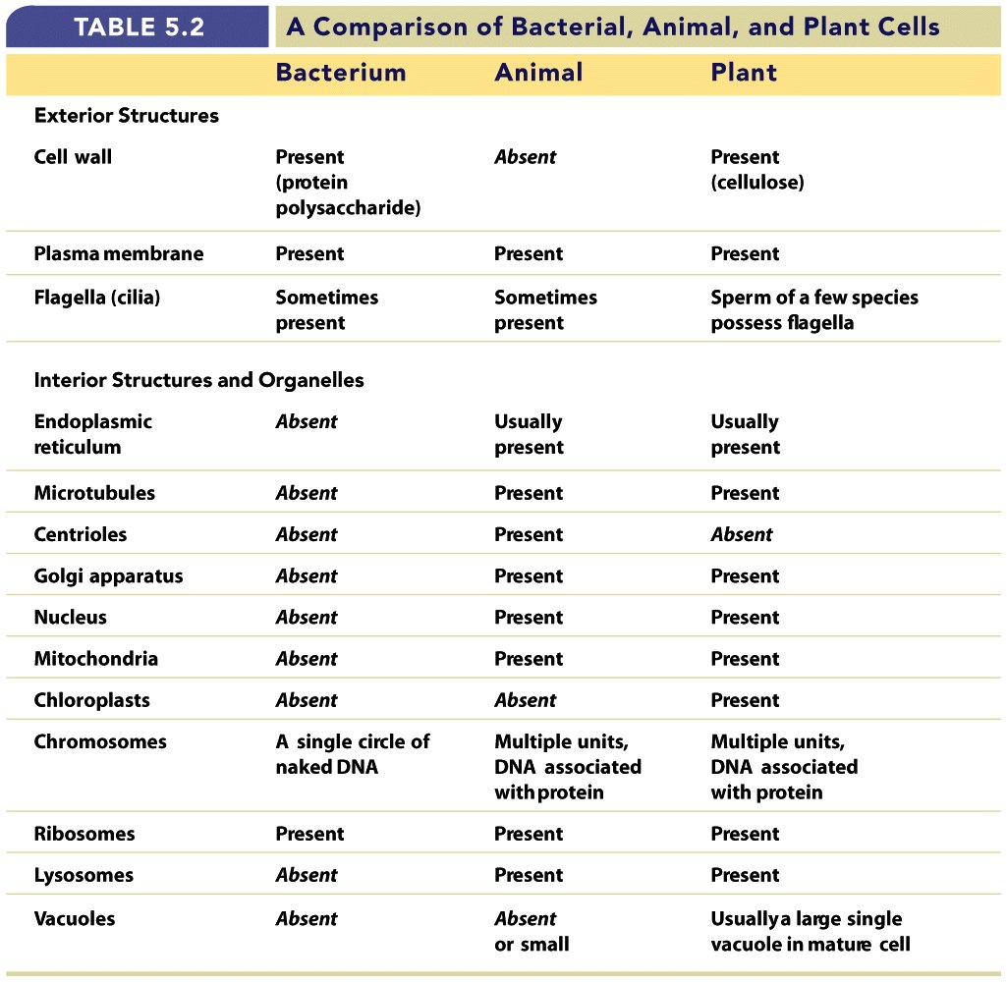

Slide 54
Molecule Movement & Cells
Passive Transport
Active Transport
Endocytosis
(phagocytosis & pinocytosis)
Exocytosis

Slide 55
Passive Transport
No energy required
Move due to gradient
differences in concentration, pressure, charge
Move to equalize gradient
High moves toward low

Slide 56
Types of Passive Transport
1. Diffusion
2. Osmosis
3. Facilitated diffusion

Slide 57
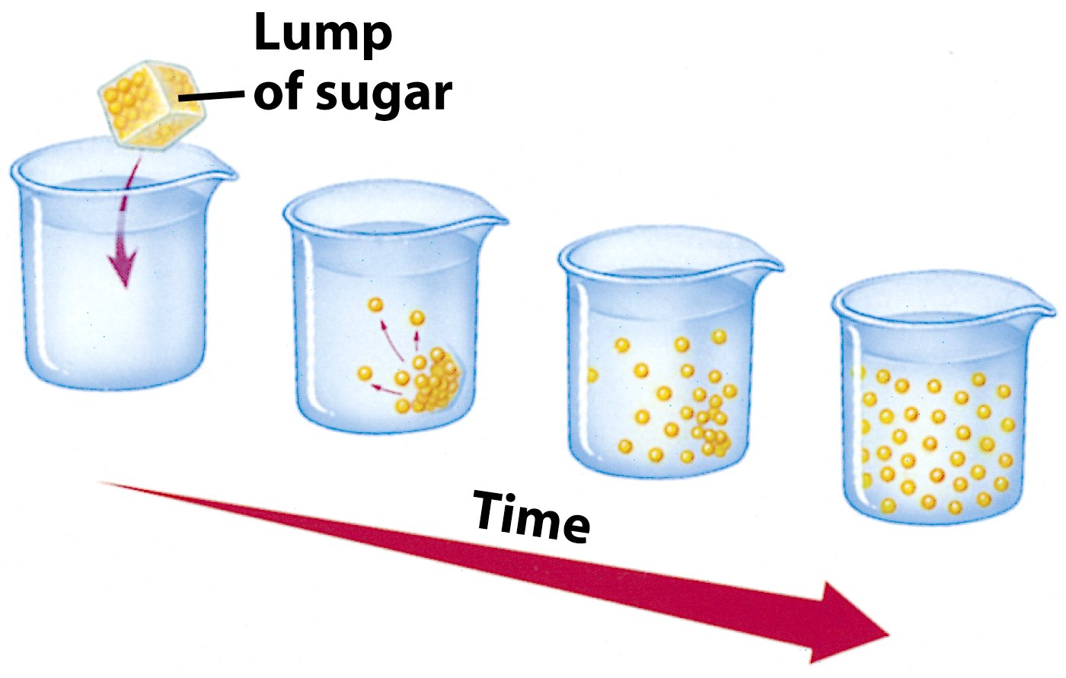
Diffusion
Molecules move to equalize concentration

Slide 58
Osmosis
Special form of diffusion
Fluid flows from lower solute concentration
Often involves movement of water
Into cell
Out of cell

Slide 59
Solution Differences & Cells
solvent + solute = solution
Hypotonic
Solutes in cell more than outside
Outside solvent will flow into cell
Isotonic
Solutes equal inside & out of cell
Hypertonic
Solutes greater outside cell
Fluid will flow out of cell

Slide 60
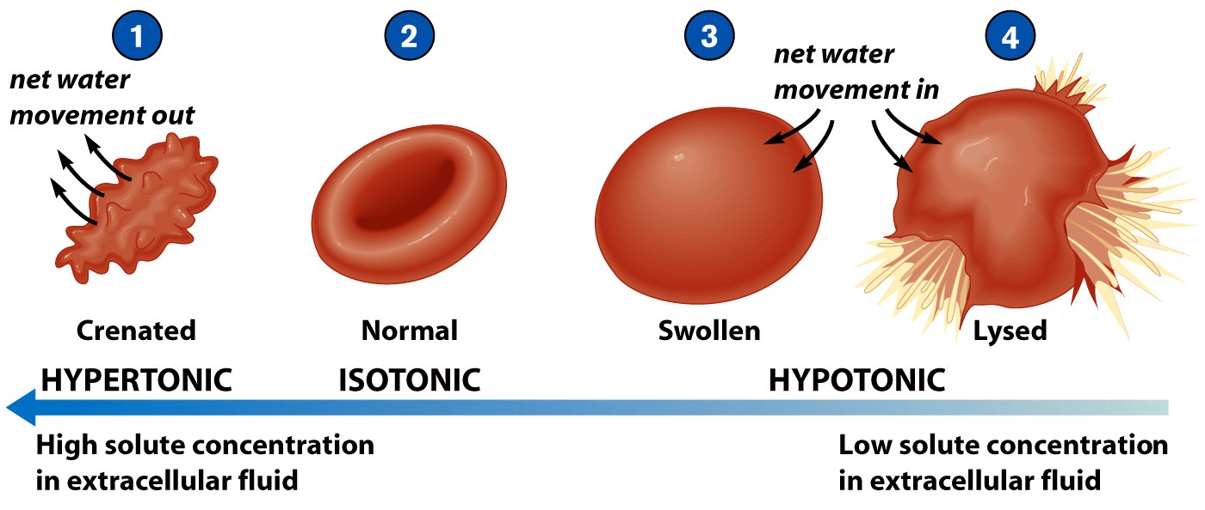

Slide 61
Facilitated Diffusion
Differentially permeable membrane
Channels (are specific) help molecule or ions enter or leave the cell
Channels usually are transport proteins
(aquaporins facilitate the movement of water)
No energy is used

Slide 62
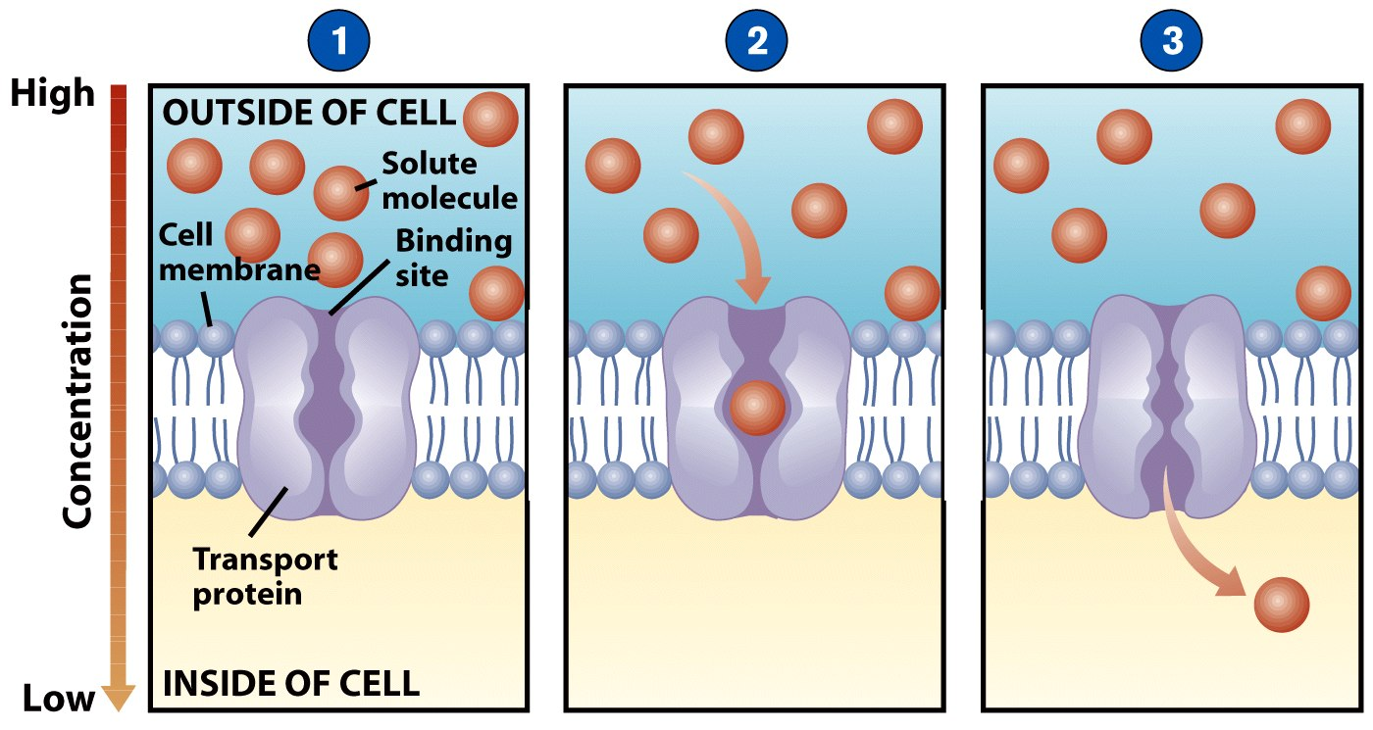
Process of Facilitated Transport
Protein binds with molecule
Shape of protein changes
Molecule moves across membrane

Slide 63
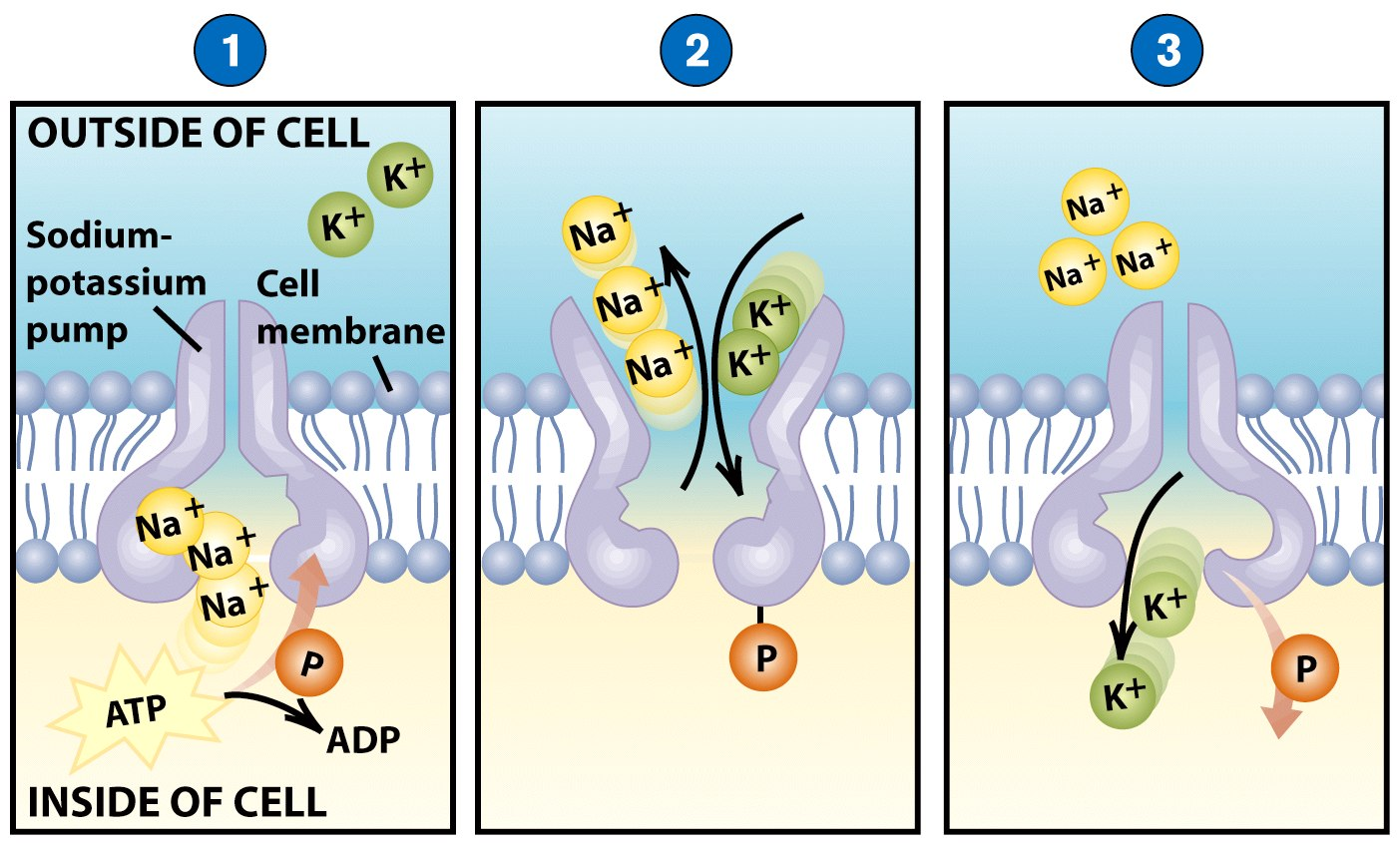
Active Transport
Molecular movement
Requires energy (against gradient)
Example is sodium-potassium pump

Slide 64
Endocytosis
Movement of large material
Particles
Organisms
Large molecules
Movement is into cells
Types of endocytosis
bulk-phase (nonspecific)
receptor-mediated (specific)

Slide 65
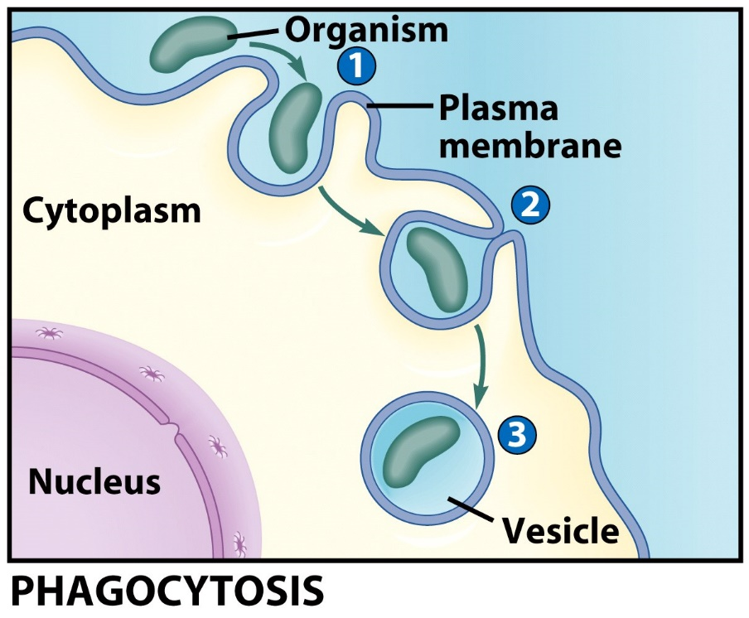
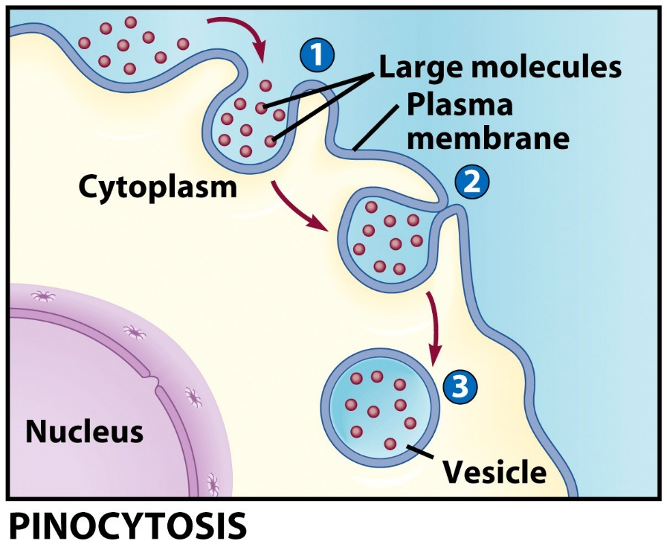
Process of Endocytosis
Plasma membrane surrounds material
Edges of membrane meet
Membranes fuse to form vesicle

Slide 66
Forms of Endocytosis
Phagocytosis – cell eating
Pinocytosis – cell drinking

Slide 67
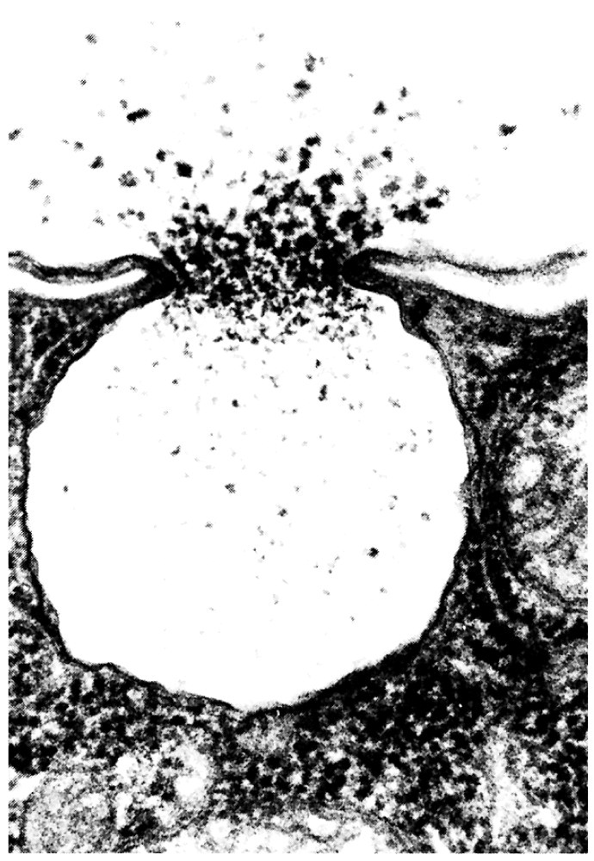
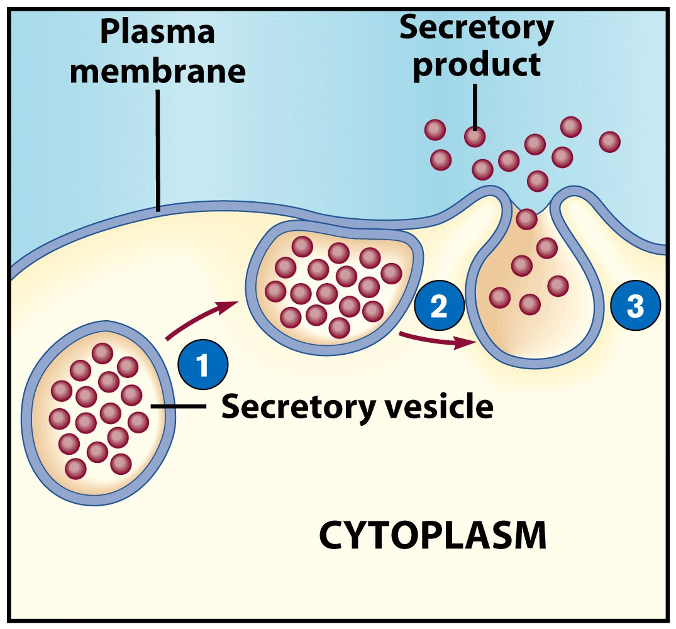
Exocytosis
Reverse of endocytosis
Cell discharges material

Slide 68
Exocytosis
Vesicle moves to cell surface
Membrane of vesicle fuses
Materials expelled

Slide 69
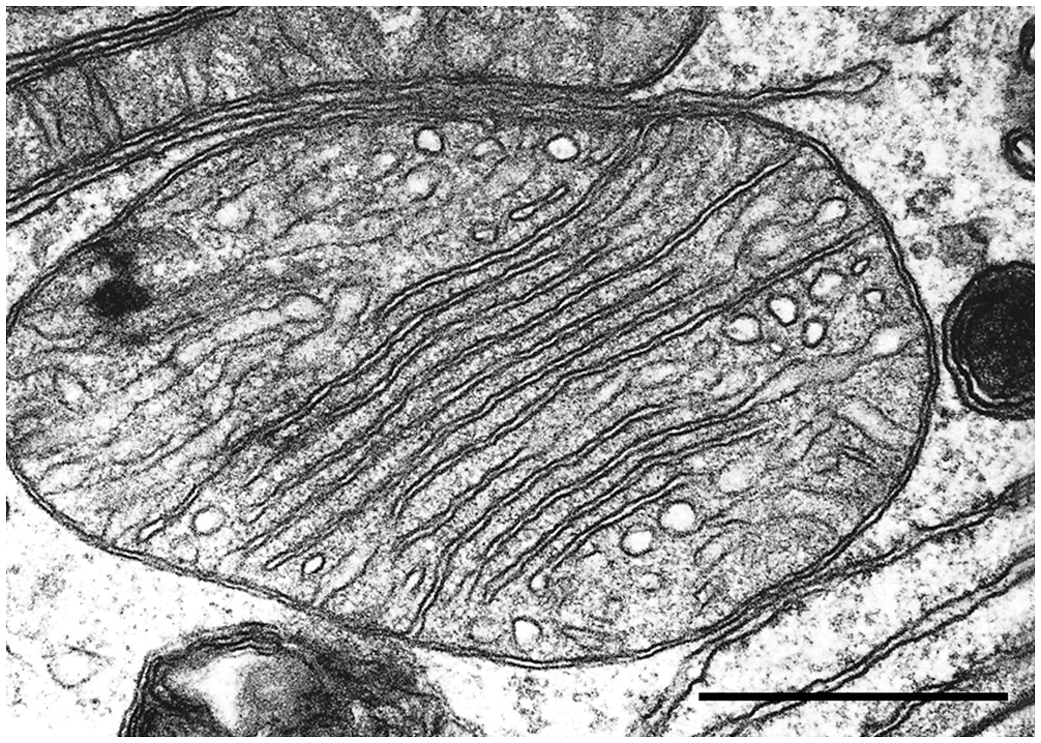
End Chapter 5

